Slide 1
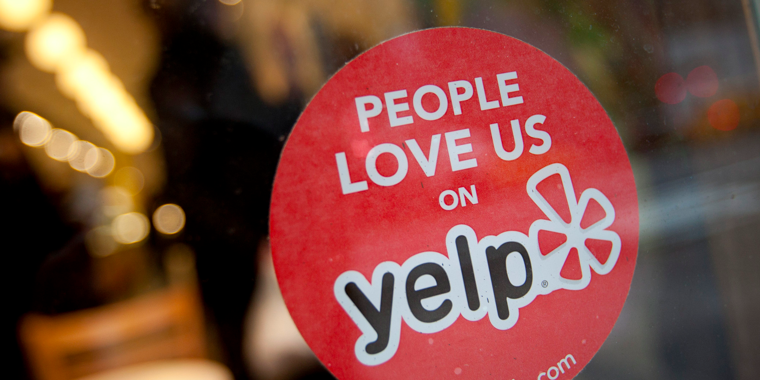
Yelp Trendsetters
Karissa Nanetta

Slide 2
Agenda
Why try to identify trendsetters?
Who is a trendsetter?
How did I identify trendsetters?
What do the results look like?
What next?

Slide 3
Purpose
Identifying the trendsetters among Yelp users

Slide 4
Why try to identify trendsetters?
Trendsetters create valuable new content
Trendsetters increase other users’ engagement
Gain insight on how Yelp can create more trendsetters in the future

Slide 5
Why try to identify trendsetters?
Trendsetters create valuable new content
Trendsetters increase other users’ engagement
Gain insight on how Yelp can create more trendsetters in the future
= more people will use Yelp
= ad revenue!
$$$

Slide 6
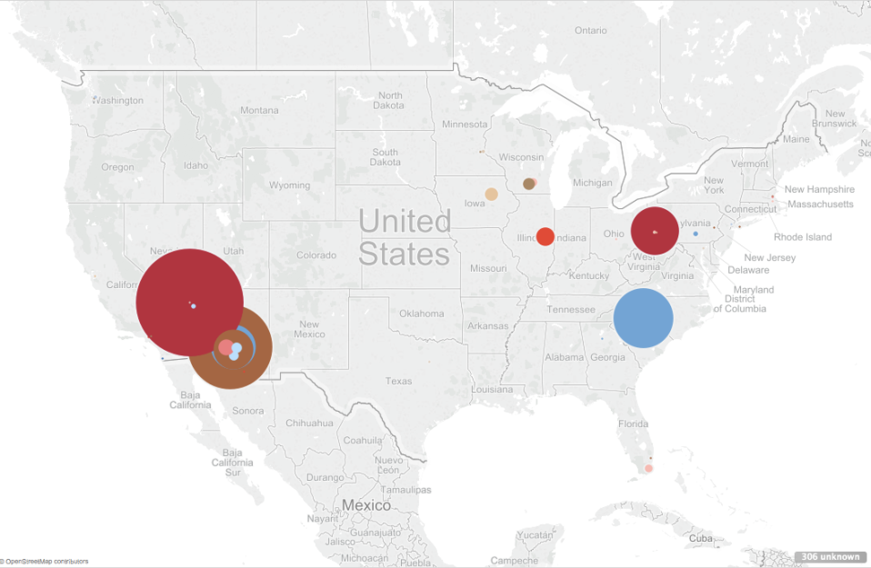
What’s in the Yelp data? Ten different cities
https://public.tableau.com/profile/karissa.nanetta#!/vizhome/YelpBusinessLocations/Locations

Slide 7
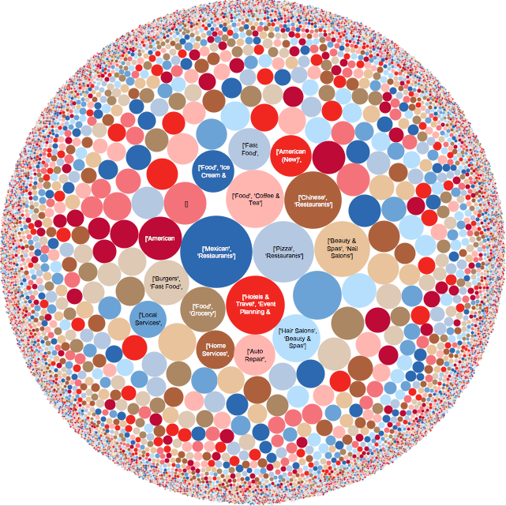
What’s in the data?
Very diverse
businesses
https://public.tableau.com/profile/karissa.nanetta#!/vizhome/YelpBusinessDiversity/BusinessCounts

Slide 8
What’s in the Yelp data?
5 separate datasets:
Business (60K+)
Reviews (1M+)
User (366K+)
Tip
Check-in

Slide 9
Who is a trendsetter?
Early reviewer
Popular businesses
Huge network
Trendsetters

Slide 10
Who is a trendsetter?
Early Reviewer
How soon does a Yelp user leave a review?
Popular Businesses
How well are the businesses they review doing?
Huge Network
How many people are listening to the trendsetters?

Slide 11
Who is a trendsetter?
Early Reviewer
Popular Businesses
Huge Network
Feature
engineering

Slide 12
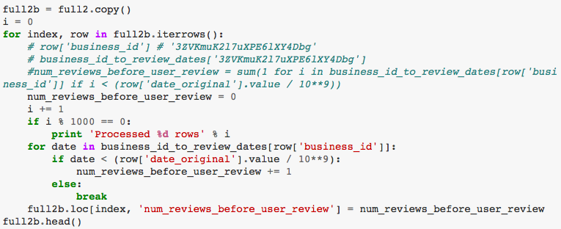
Who is a trendsetter?
Early Reviewer
Popular Businesses
Huge Network
Feature
engineering

Slide 13
How did I identify trendsetters?

Slide 14
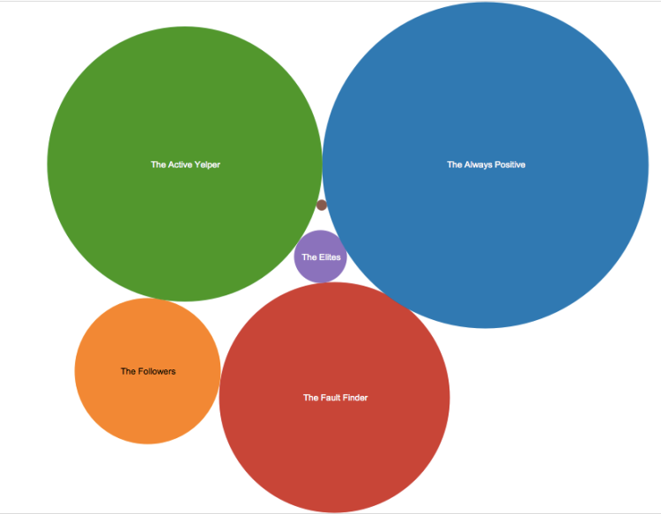
K-means Clustering to the rescue!

Slide 15
K-means Clustering
Further analysis to determine the subset of trendsetters

Slide 16
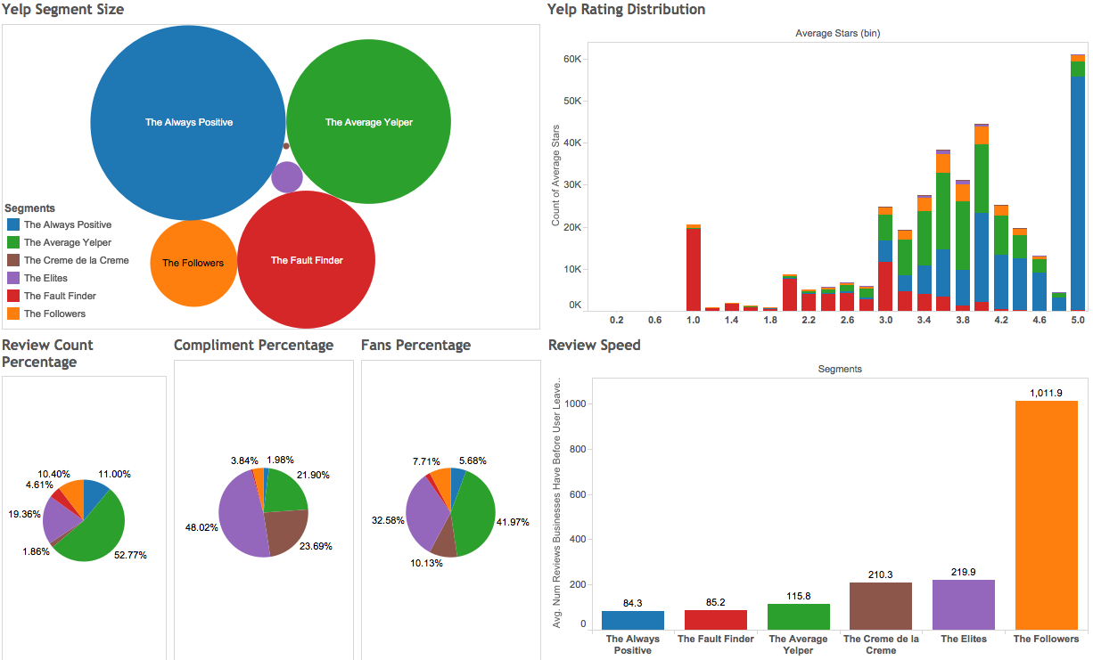
K-means gave 6 distinct clusters

Slide 17
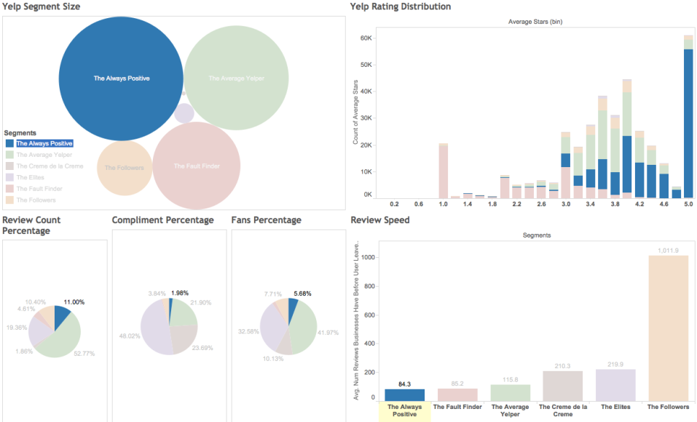
The “Always Positive” might be friends & family of the businesses… OR BOTS!
Reviews very early, always positive reviews, unpopular businesses

Slide 18
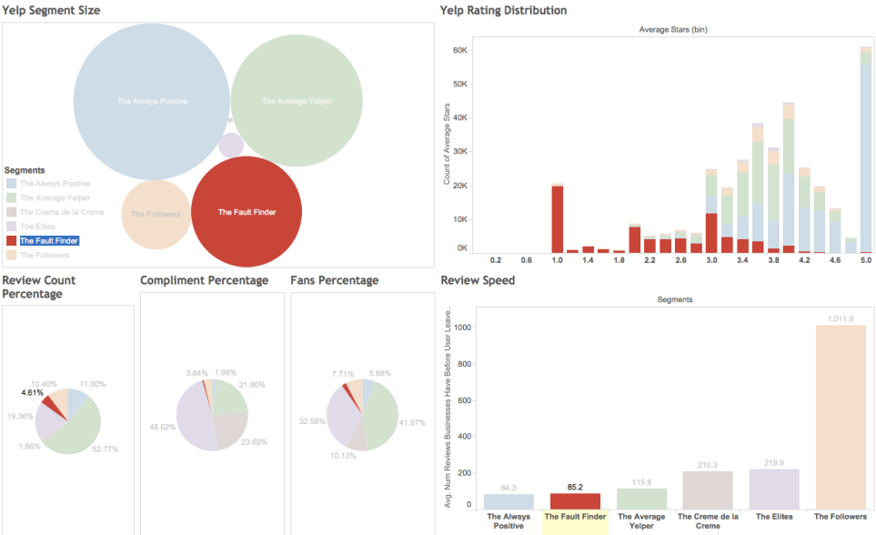
A large group in Yelp are “Fault-Finders”
Reviews very early, only gives negative reviews

Slide 19
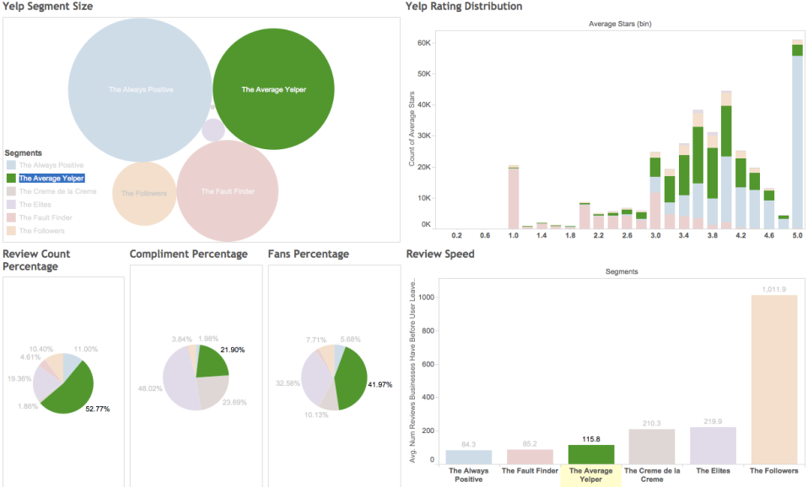
The “Average Yelper” are the closest to overall average population
Review ~50 businesses fairly, have several friends, average speed

Slide 20
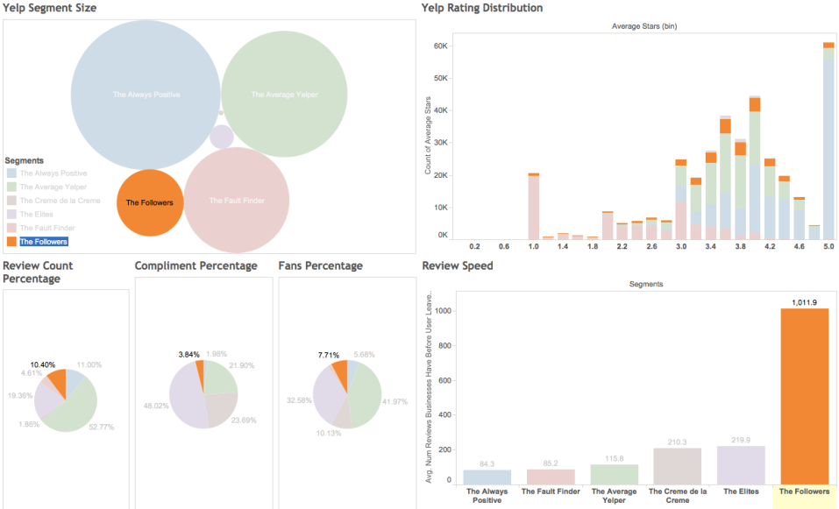
I fall under “The Followers”
Only visit businesses with 4+ stars and hundreds of reviews

Slide 21
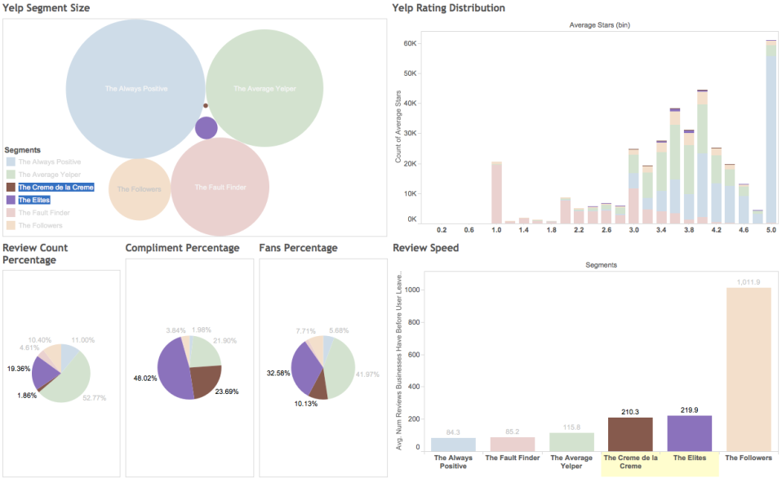
The “Crème de la Crème” & “Elites” are good candidates to be the trendsetters
Large following, popular businesses, reviews relatively early

Slide 22
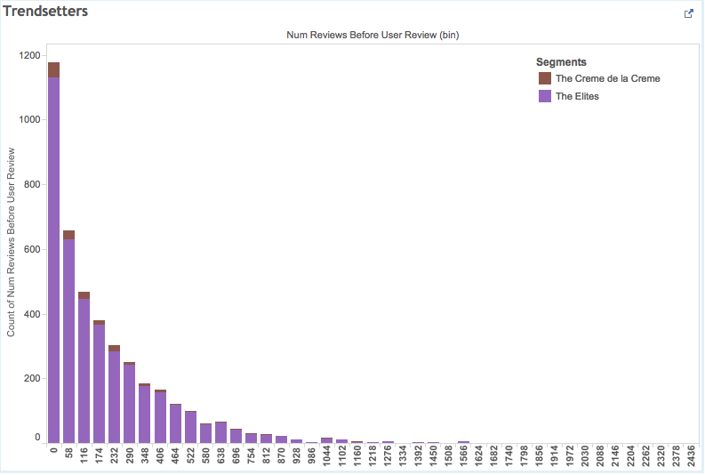
So, who are the trendsetters?

Slide 23
So, who are the trendsetters?
Earliest reviewers of “Crème de la Crème” and “Elites”
= Final group of Trendsetters

Slide 24
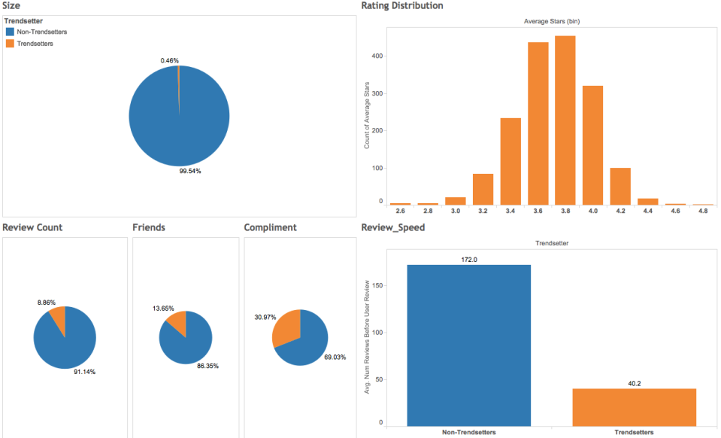
So, who are the trendsetters?

Slide 25

What can Yelp do next?
Give a badge to the trendsetters, so other users know who they are and follow them
Give trendsetters gift cards to try out new businesses as a form of marketing

Slide 26
What else can we do?
Predict whether a new user will become a trendsetter (supervised learning)
Analyze effects on types of businesses (restaurants, laundromats, doctors, etc.)
Given more data…
Perform longitudinal analysis
Analyze user profile texts to detect bots

Slide 27


